Slide 1

Election Result Prediction Using Sentiment Analysis

Slide 2

Elections decide Nation’s Fate
Problem Formulation
Sentiment Analysis
Politics
Business
Donald Trump
Joe Biden

Slide 3
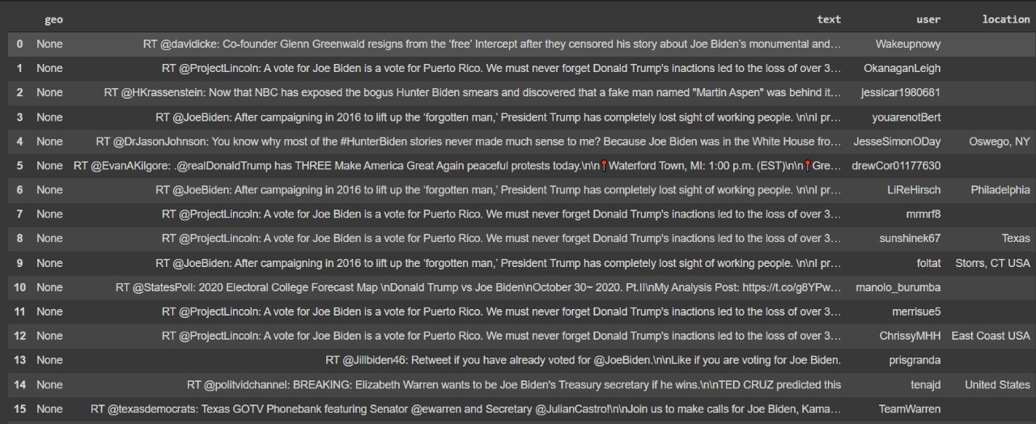
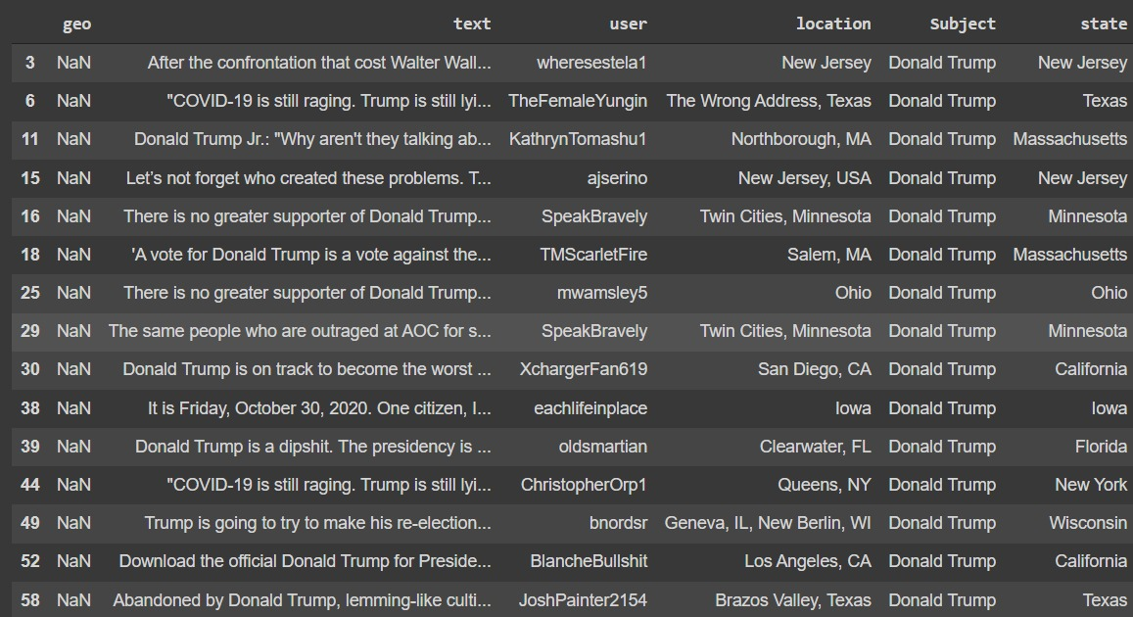
Details
Before
Cleaning
Mapping
Recollected data
After
Intro to data structures — pandas 1.4.3 documentation (pydata.org)

Slide 4
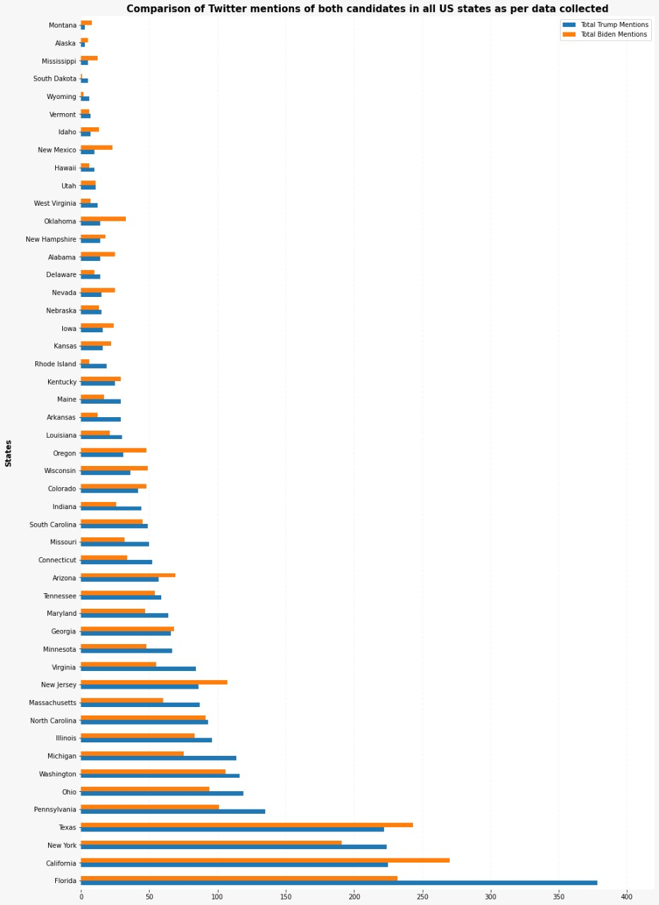
Details
Cleaning
Mapping
Recollected data
Separate Data
Chart Visualization — pandas 1.4.3 documentation (pydata.org)

Slide 5
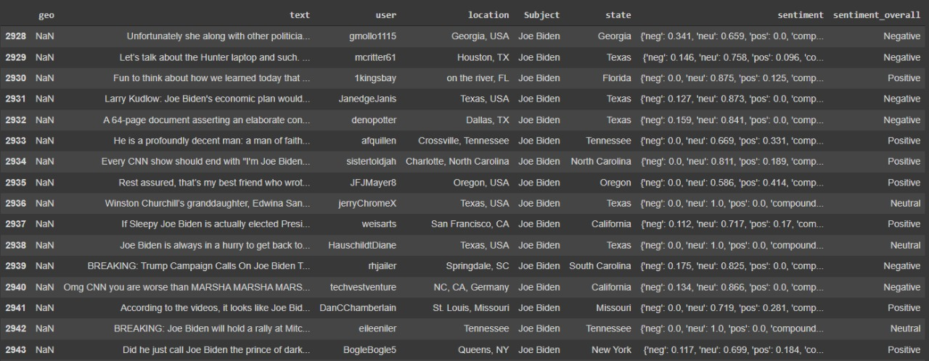
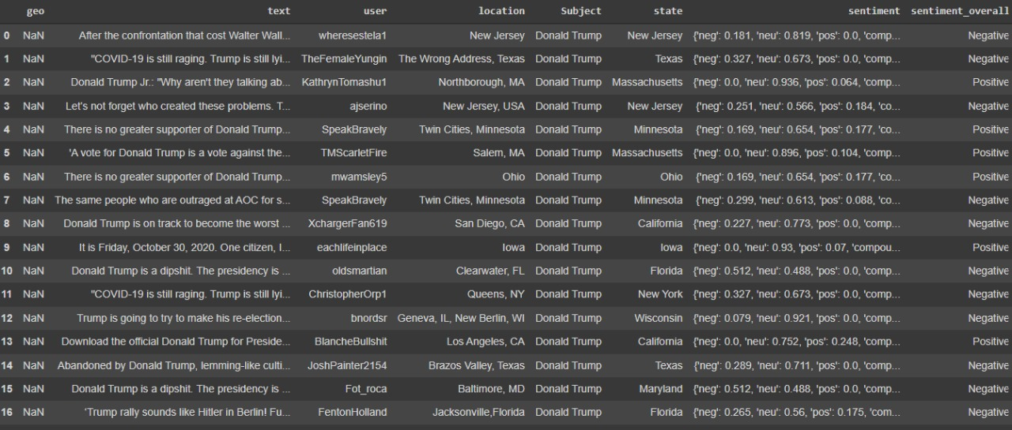
Details
Biden
Cleaning
Mapping
Recollected data
Separate Data
Sentiment Analysis
Trump
Vader
Calderon, Pio. “VADER Sentiment Analysis Explained.” Medium, 31 Mar. 2018, https://medium.com/@piocalderon/vader-sentiment-analysis-explained-f1c4f9101cd9.

Slide 6
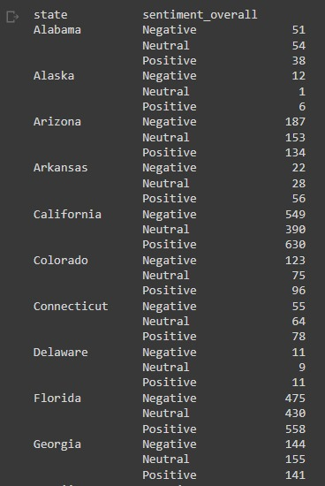
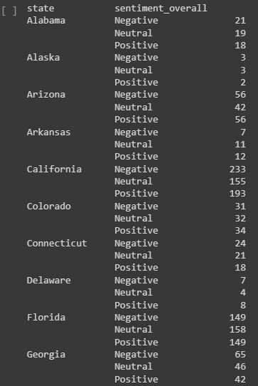
Details
Trump
Biden
Cleaning
Mapping
Recollected data
Separate Data
Sentiment Analysis
Vader
Calderon, Pio. “VADER Sentiment Analysis Explained.” Medium, 31 Mar. 2018, https://medium.com/@piocalderon/vader-sentiment-analysis-explained-f1c4f9101cd9.

Slide 7
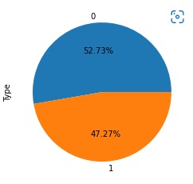
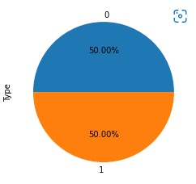
Details
Before
Cleaning
Mapping
Recollected data
Separate Data
Sentiment Analysis
After
Vader
Text Blob
“Undersampling.” CORP-MIDS1 (MDS), https://www.mastersindatascience.org/learning/statistics-data-science/undersampling/

Slide 8
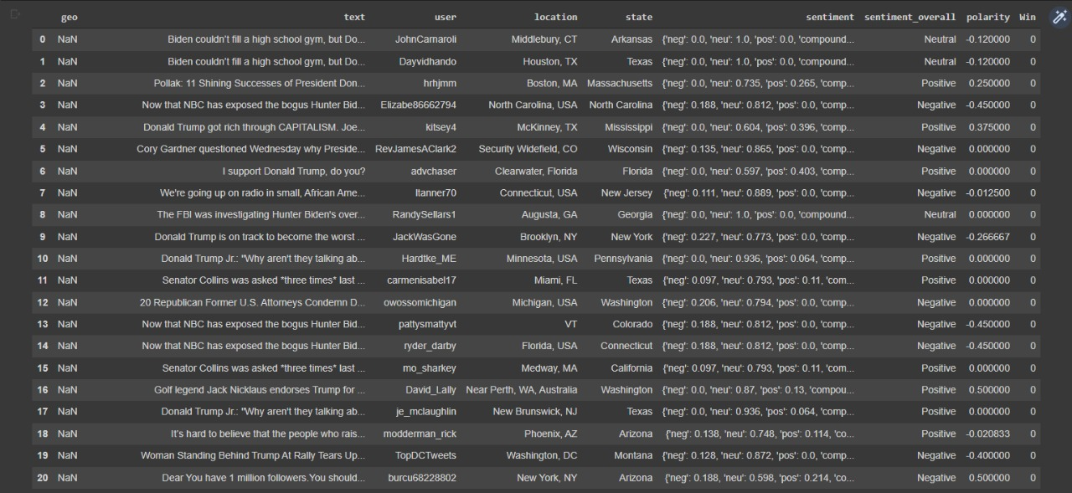
Details
Ploarity
Cleaning
Mapping
Recollected data
Separate Data
Sentiment Analysis
Vader
Text Blob
Shah, Parthvi. “My Absolute Go-To for Sentiment Analysis — TextBlob.” Medium, 6 Nov. 2020, https://towardsdatascience.com/my-absolute-go-to-for-sentiment-analysis-textblob-3ac3a11d524

Slide 9
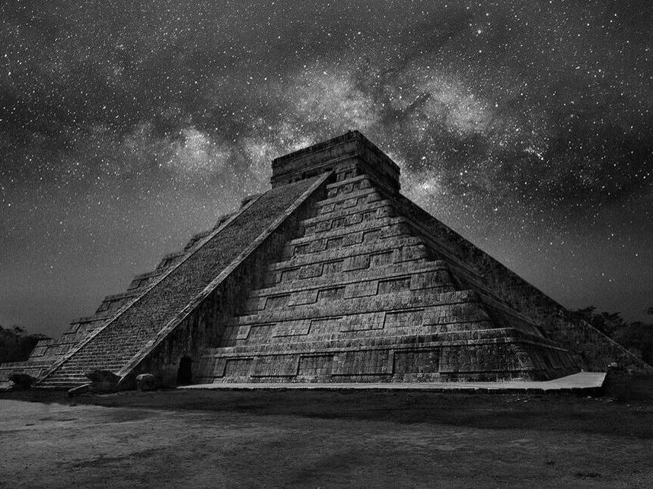
Decision Factor
Sentiment Analysis
Tweeter Data
Vader
Text Blob
Insufficient Data
Trump Win
Biden Win
Distracting votes less than margin
Distracting votes more than margin
Pos
Neg

Slide 10
Machine Learning Models
ML Models
Logistic Regression
SVM
Decision Tree
Random Forest
Guassian NB
Knn Classifier
Neural Network
54.83%
55.28%
68.28%
68.21%
53.90%
66.30%
51.30%
Champion Model

Slide 11

References
Jyoti Ramteke, Darshan Godhia, Samarth Shah, and Aadil Shaikh. Election Result Prediction Using Twitter sentiment Analysis, 2018
Salunkhe, Pritee. “Twitter Based Election Prediction and Analysis.” International Research Journal of Engineering and Technology, https://www.irjet.net/archives/V4/i10/IRJET-V4I1094.pdf.
Chart Visualization — pandas 1.4.3 documentation (pydata.org)
Intro to data structures — pandas 1.4.3 documentation (pydata.org)
Calderon, Pio. “VADER Sentiment Analysis Explained.” Medium, 31 Mar. 2018, https://medium.com/@piocalderon/vader-sentiment-analysis-explained-f1c4f9101cd9.
“Undersampling.” CORP-MIDS1 (MDS), https://www.mastersindatascience.org/learning/statistics-data-science/undersampling/
Shah, Parthvi. “My Absolute Go-To for Sentiment Analysis — TextBlob.” Medium, 6 Nov. 2020, https://towardsdatascience.com/my-absolute-go-to-for-sentiment-analysis-textblob-3ac3a11d524

Slide 12
THANKS

